Slide 1
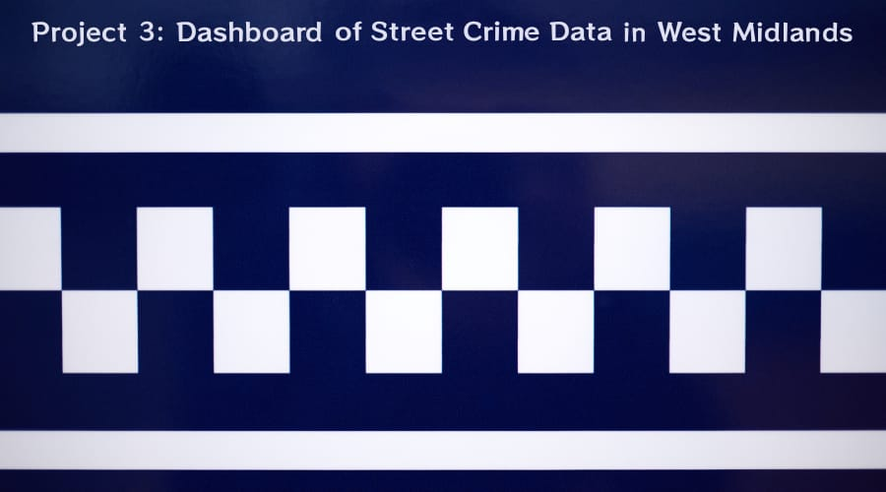
Team members
Gwendoline Grenu, Habib Rehman, Mushfiqur Rahman, Peter Lehel

Slide 2
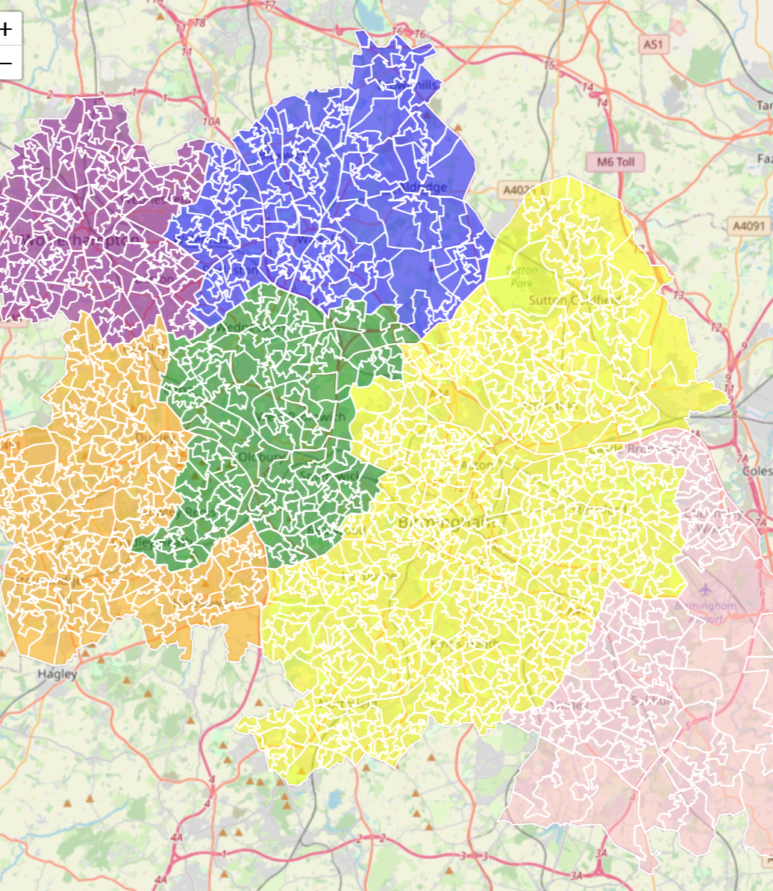


Story
Living in West Midlands area
Curious of street crime
Use newly acquired tools to map spatial distribution of street crime
Investigate what types of areas have higher count of crime

Slide 3
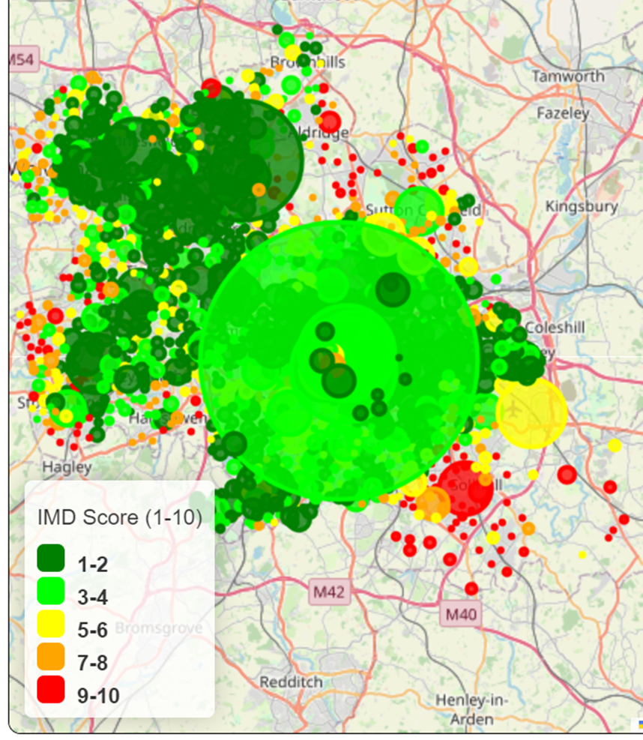
Source Data
Police Data: https://data.police.uk/data/#
Data is available in monthly breakdown, between the period of:
October 2020 – September 2023
Census Data/Geolookups: https://github.com/drkane/geo-lookups/tree/master
Boundaries of Local Authorities and Central Geocoordinates for LSOAs
IMD (Index of Multiple Deprivation) Data: https://www.gov.uk/government/statistics/english-indices-of-deprivation-2019
2019 IMD Data (last available)

Slide 4
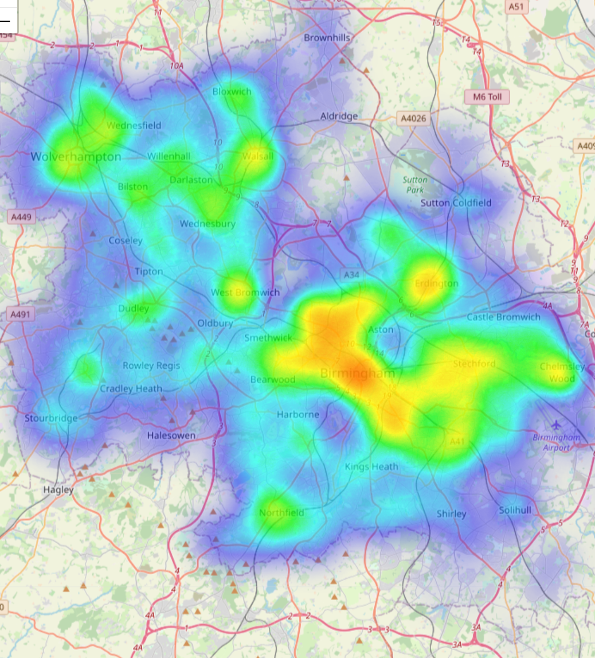
Summary of Methods
[1] Import data as CSV / GeoJSON [Python / Jupyter Notebook]
[2] Manipulate, clean, filter and export [Pandas / Geopandas / SQLite]
[3] Use Flask to power an App that reads SQL files, transforms to GeoJSON for Dashboard of Street Crime [Flask / JS / HTML / CSS / Bootstrap]

Slide 5
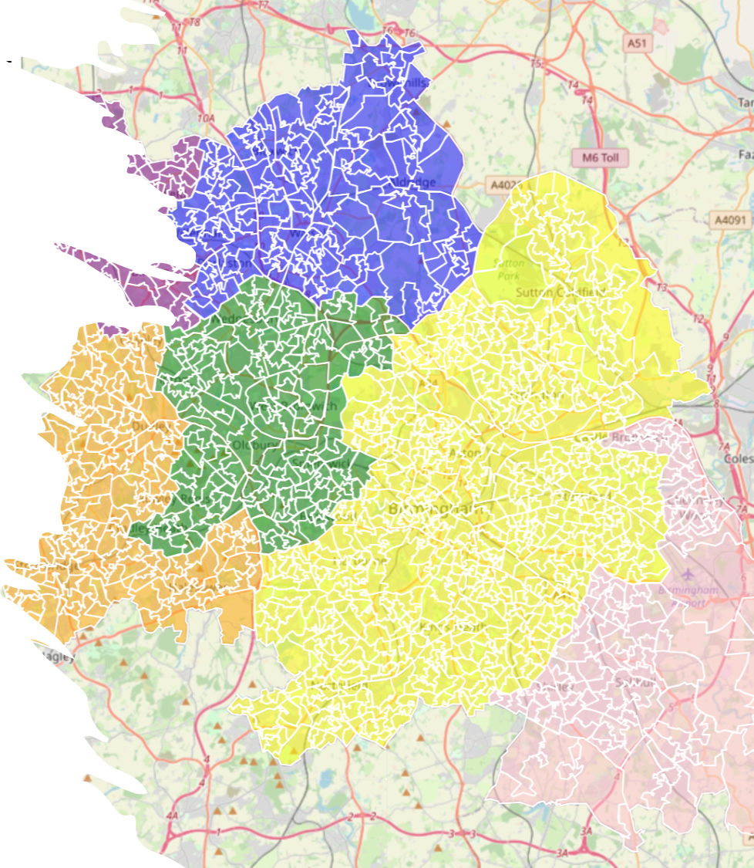
Now we will show:
GitHub Repo and Jupyter Notebook [Habib]
Groupby / Filter / Flask App (internal) [Mushfiq]
Flask App (running) [Gwen]
Conclusion [Peter]

Slide 6
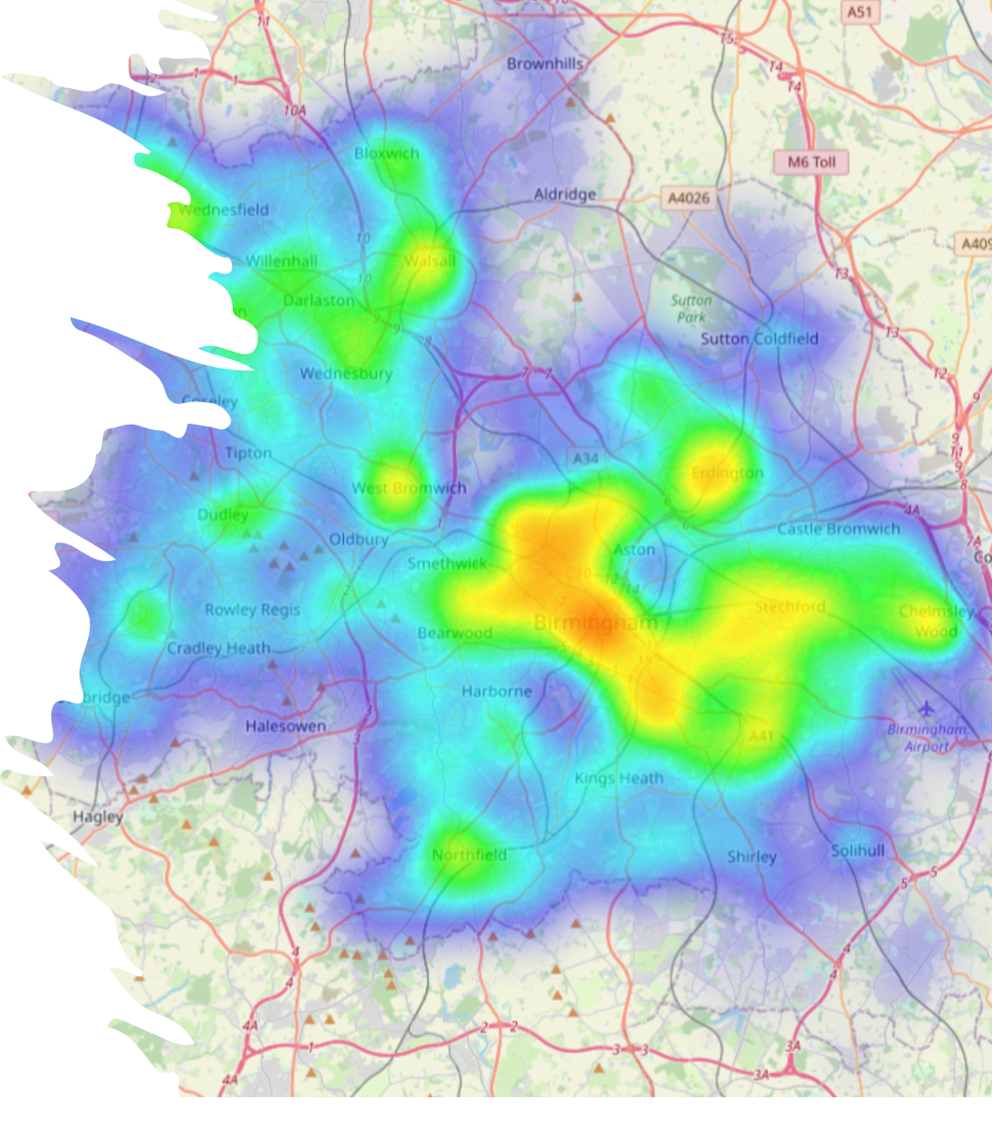
Conclusion
1. These tools are effective in preparing and visualizing data
2. Easy to observe geographical distribution of data
3. For example: clear concentrations of street crimes in city centres where people gather

Slide 7
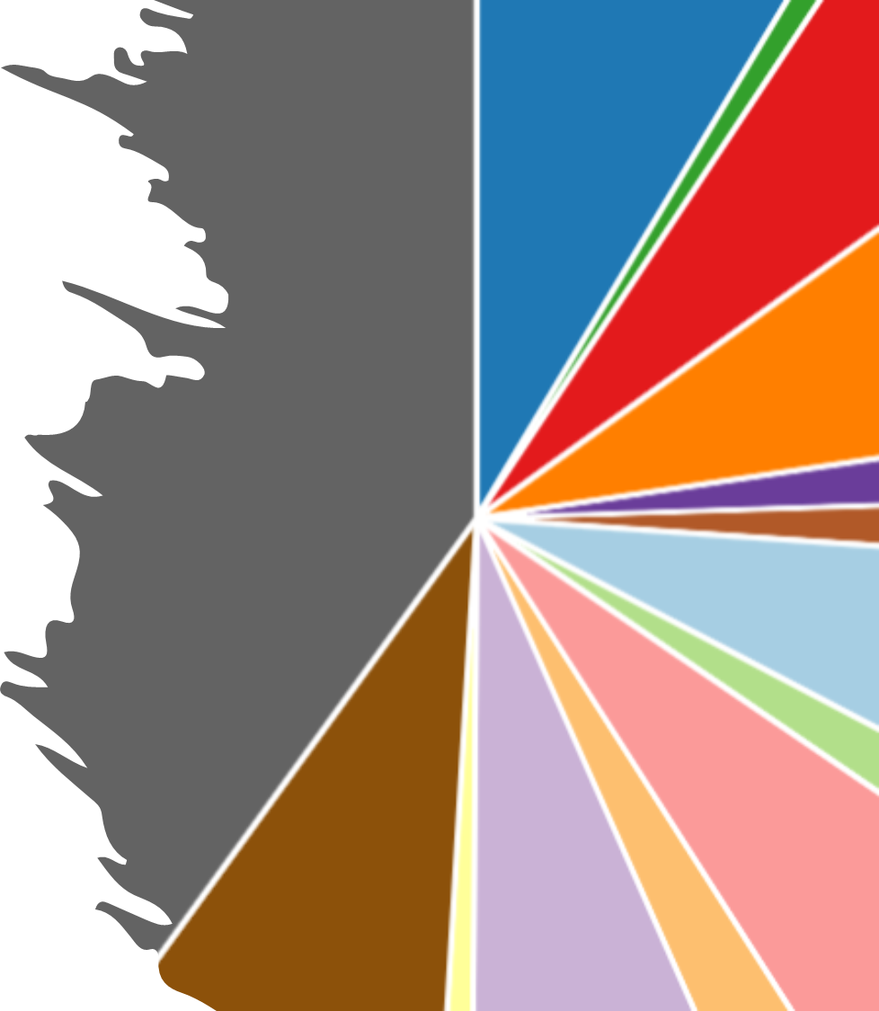
Further Work
1. Automate data retrieval (API/webscraping)
2. Produce multiple dropdown filters for each visualization such as by Month and by Crime type
3. Integrate user input via search bars to display user-specified requests

Slide 8
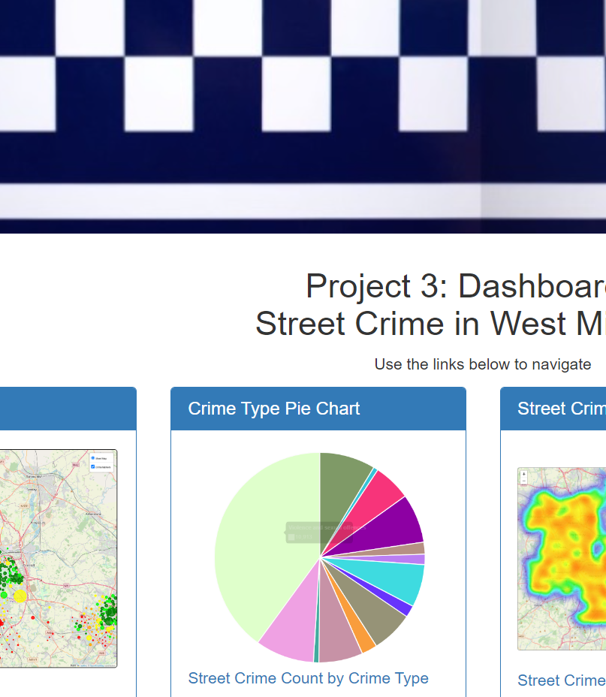
Any Questions?
Thank you for listening

